Slide 1
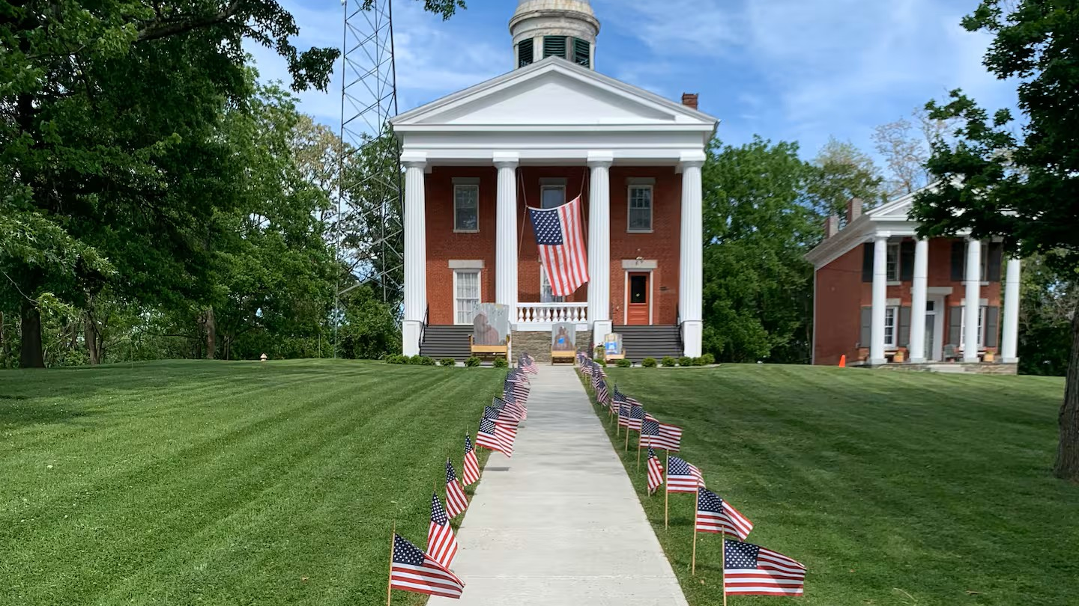
Village of Ovid Comprehensive Plan Update Workshop
July 9, 2026

Slide 2
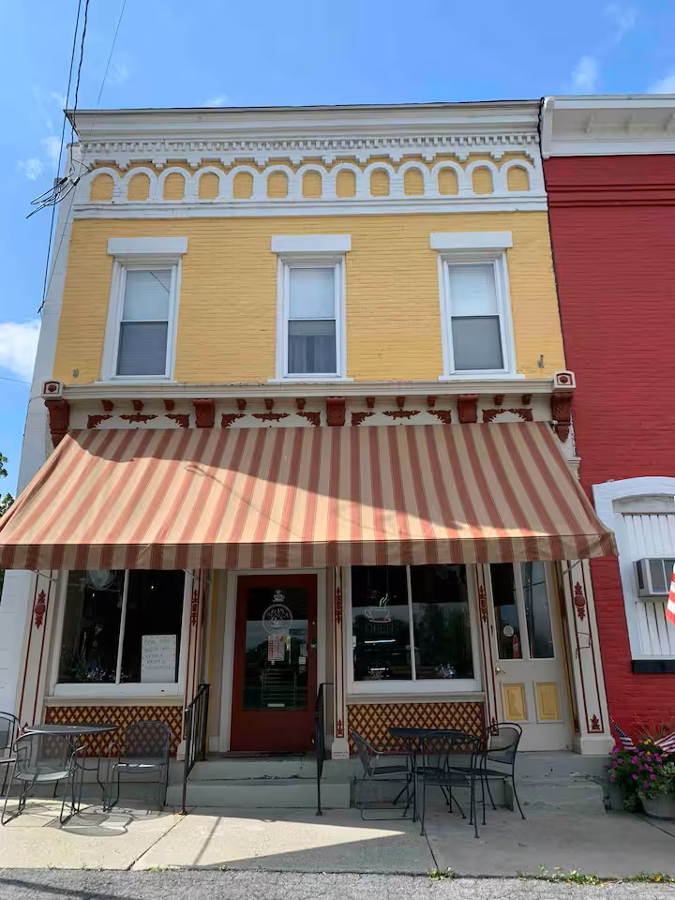
Agenda
What is a comprehensive plan & connection to other projects
Planning process
What we have heard
Q&A
Activities

Slide 3
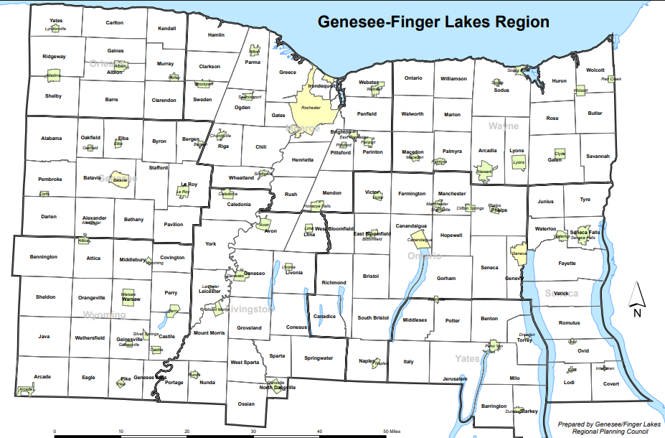
Genesee/Finger Lakes Regional Planning Council
Local planning council serving the nine-county Genesee- Finger Lakes region.
We work with municipalities throughout the region providing planning and local government technical assistance.
The Village of Ovid has contracted with us to provide technical assistance in updating the comprehensive plan.​

Slide 4
Three Projects. One Common Purpose
Downtown Revitalization Plan
Desire for a stronger, safer, more vibrant Ovid
Comprehensive Plan
Active Transportation Plan
Notes:
The Village and Town are working on three separate but interrelated projects that support the Village and have one common purpose. Each project will
Community engagement
Shared questions about form, land use, character, values, and priorities
Support for local NY Forward Readiness
Focus on recovery after the fire
No project forces construction or zoning

Slide 5
Three Projects. One Common Purpose
Comprehensive Plan
Genesee/Finger Lakes Regional Planning Council
Focused on setting the vision, and long-term goals of Ovid
Guides land use, housing, and economic growth for the next decade.
“What do we want Ovid to become?”
Downtown Revitalization Plan
n.site:architecture & Highland Planning
Focused on the elements of design.
Builds local development tools and Investment capacity.
Tests feasibility + cost impacts of desired forms/developments.
Develops parcel redevelopment options.
“What should downtown look & feel like?”
Active Transportation Plan
Genesee Transportation Council, Seneca County, B&L
Focused on safety, mobility, and connections.
Improves walking/biking safety.
Links downtown to the lakes and beyond.
What destinations matter most & how do we get there?”

Slide 6
What is a Comprehensive Plan?
Long-range policy document designed to guide the future physical, economic, and social development of Ovid. This will act as the Village's "blueprint” by establishing a shared 20- to 30-year vision and identifying the goals needed to get there.
Establishes goals, future needs and strategies
Supports a high quality of life
Gives residents a voice in decisions
Balances growth, services, & environmental protection
Prepares for change, challenges, & opportunities

Slide 7
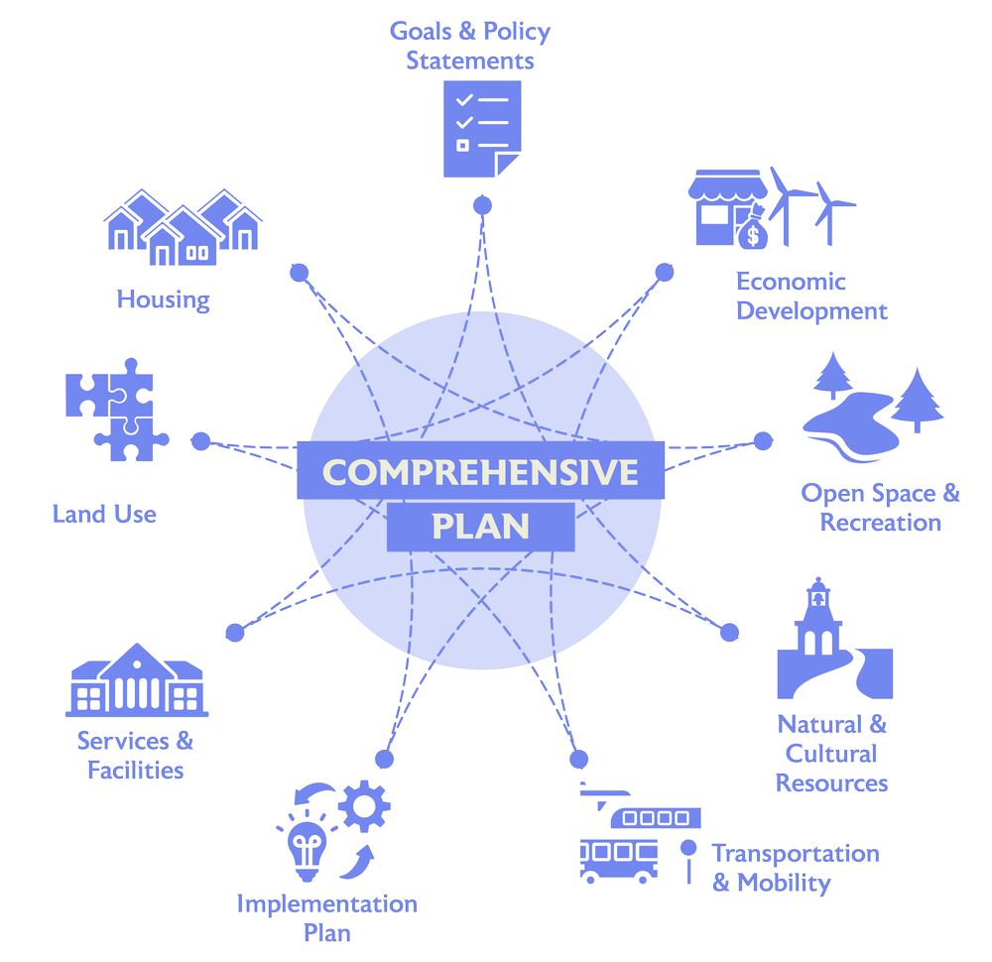
Key Elements
Notes:
The circles represent some of the key deliverables
Red are other ongoing projects

Slide 8
Planning Approach
Launch
  Coordinating with other project partners
  Review past plans, projects, & data.
Listening
  Engagement Plan
  Community Survey
Visioning
  Community Workshop
  Goal identification
Action
  Develop strategies & actions
  Implementation Plan
Adoption
  Public Hearing
  SEQR
  Planning Board
July- September 2026
September-October 2026
May-June 2026
May-July 2026
October 2026

Slide 9
What We Have Heard
What Residents Value
Small-town character
Historic charm
Safety
Strong community
Rural setting
Community Priorities
Revitalize downtown
Support local businesses
Expand housing choices
Reuse vacant buildings
Improve community amenities
Future Vision
A vibrant downtown
More local services and jobs
Housing for all life stages
Preserve Ovid's character while planning for the future

Slide 10
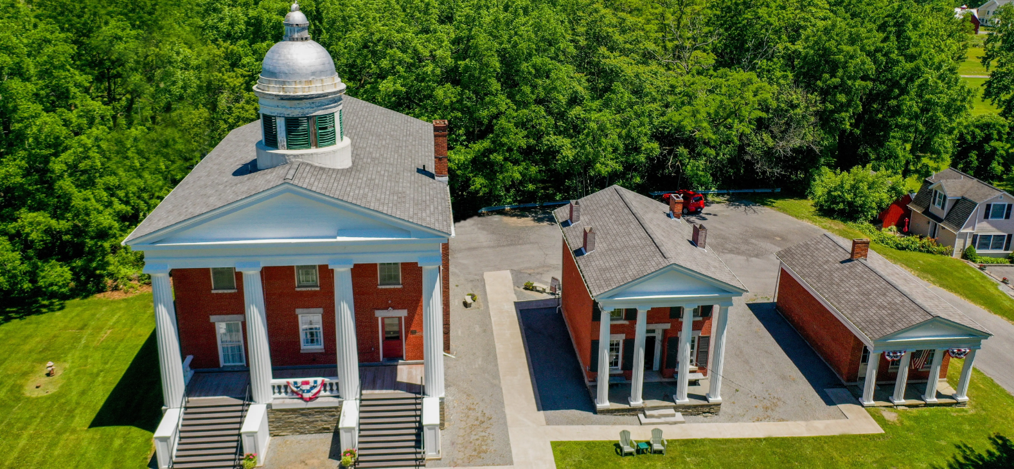
Ovid’s Draft Vision
All Roads Lead To Ovid
Draft vision from the survey responses and from committee:
“Ovid is a vibrant and welcoming gateway between the lakes, where history, agriculture, culture, and community come together. Guided by a strong sense of place and inclusiveness, the village will celebrate its heritage, strengthen its downtown as the heart of community life, support local businesses, attract investment, and embrace thoughtful growth that preserves its unique character while creating opportunities and enhancing quality of life for residents of all ages, now and for generations to come.”
Notes:
This is a draft vision that the committee came up with, but the goal of today is to make sure that this vision is the one that should be carried through into the compressive plan. From this exercise we want to keep track of recurring themes and make sure that they are included moving forward

Slide 11
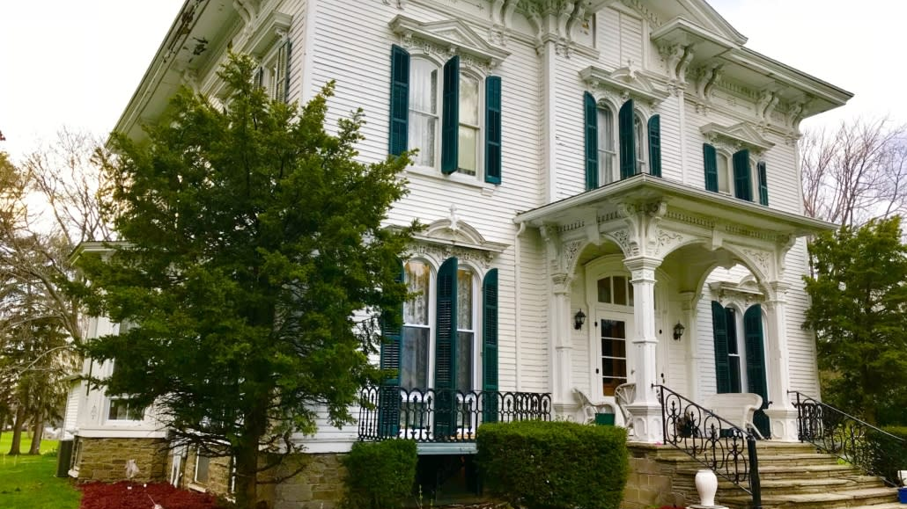
Questions?

Slide 12

Thank You!
Please Reach Out
Jenny Loewenstein
Sustainability Program Manager,
G/FLRPC
Jloewenstein@gflrpc.org

